Slide 1
External Sorting
courtesy of Joe Hellerstein for some slides

Slide 2
Why Sort?
A classic problem in computer science!
Data requested in sorted order
  e.g., find students in increasing gpa order
First step in bulk loading B+ tree index.
Useful for eliminating duplicates (Why?)
Useful for summarizing groups of tuples
Sort-merge join algorithm involves sorting.
Problem: sort 100Gb of data with 1Gb of RAM.
  why not virtual memory?
Notes:
4

Slide 3
2-Way Sort: Requires 3 Buffers
Pass 0: Read a page, sort it, write it.
  only one buffer page is used.
  each sorted page (or subfiles) is called a run.
Pass 1, 2, 3, …, etc.:
  requires 3 buffer pages
  merge pairs of runs into runs twice as long
  three buffer pages used.
INPUT 1
OUTPUT
INPUT 2
Main memory buffers
Disk
Disk
Merging Runs
Notes:
5

Slide 4
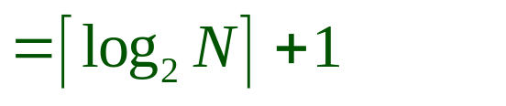
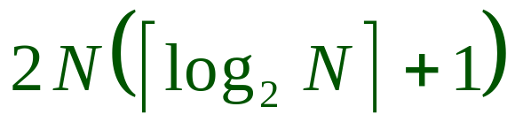
Two-Way External Merge Sort
Each pass we read + write each page in file.
N pages in the file => the number of passes
So total cost is:
Idea: Divide and conquer: sort subfiles and merge
3,4
6,2
9,4
8,7
5,6
3,1
2
Input file
PASS 0
3,4
2,6
4,9
7,8
5,6
1,3
2
1-page runs
PASS 1
2,3
4,7
1,3
2-page runs
4,6
8,9
5,6
2
PASS 2
2,3
4,4
1,2
4-page runs
6,7
3,5
8,9
6
PASS 3
1,2
2,3
3,4
8-page runs
4,5
6,6
7,8
9
Notes:
6

Slide 5
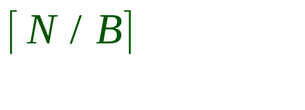
General External Merge Sort
More than 3 buffer pages. How can we utilize them?
To sort a file with N pages using B buffer pages:
  Pass 0: use B buffer pages. Produce sorted runs of B pages each.
  Pass 1, 2, …, etc.: merge B-1 runs.
INPUT 1
. . .
INPUT 2
. . .
. . .
OUTPUT
INPUT B-1
Disk
Disk
B Main memory buffers
Merging Runs
Notes:
7

Slide 6
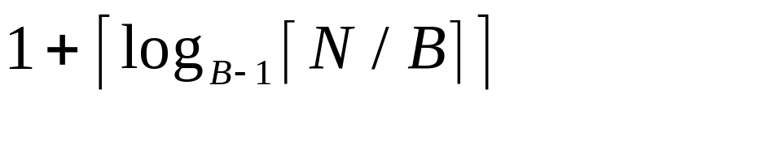
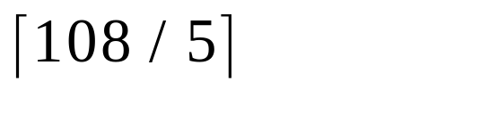
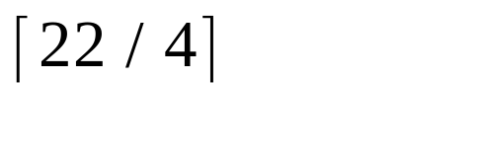
Cost of External Merge Sort
Number of passes:
Cost = 2N * (# of passes)
E.g., with 5 buffer pages, to sort 108 page file:
  Pass 0: = 22 sorted runs of 5 pages each (last run is only 3 pages)
  Pass 1: = 6 sorted runs of 20 pages each (last run is only 8 pages)
  Pass 2: 2 sorted runs, 80 pages and 28 pages
  Pass 3: Sorted file of 108 pages
Formula check: ┌log₄ 22┐= 3 … + 1 → 4 passes √
Notes:
8

Slide 7
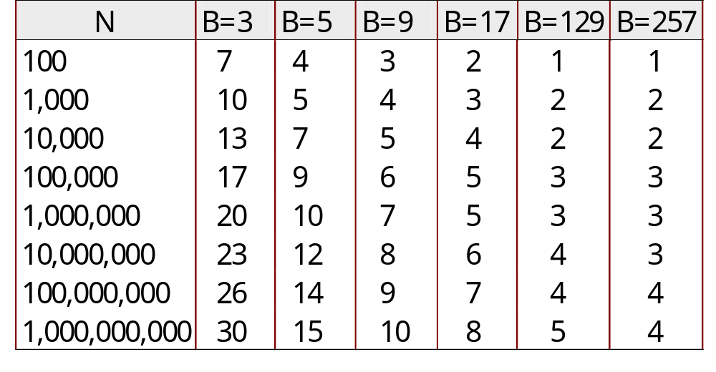
Number of Passes of External Sort
( I/O cost is 2N times number of passes)
Notes:
9

Slide 8
Blocked I/O for External Merge Sort
Do I/O a page at a time
  Not one I/O per record
In fact, read a block (chunk) of pages sequentially!
Suggests we should make each buffer (input/output) be a block of pages.
  But this will reduce fan-in during merge passes!
  In practice, most files still sorted in 2-3 passes.
Theme: Amortize a random I/O across more data read.
But pay for it in memory footprint

Slide 9
Double Buffering
Goal: reduce wait time for I/O requests during merge
Idea: 2 blocks RAM per run, disk reader fills one while sort merges the other
  Potentially, more passes; in practice, most files still sorted in 2-3 passes.
INPUT 1
INPUT 1'
INPUT 2
OUTPUT
INPUT 2'
OUTPUT'
b
Disk
INPUT k
block size
Disk
INPUT k'
B main memory buffers, k-way merge
Theme: overlap I/O and CPU activity via read-ahead (prefetching)

Slide 10
Using B+ Trees for Sorting
Scenario: Table to be sorted has B+ tree index on sorting column(s).
Idea: Can retrieve records in order by traversing leaf pages.
Is this a good idea?
Cases to consider:
  B+ tree is clustered
  B+ tree is not clustered
Good idea!
  Could be a very bad idea!
Notes:
15

Slide 11
Clustered B+ Tree Used for Sorting
Cost: root to the left-most leaf, then retrieve all leaf pages (Alternative 1)
If Alternative 2 is used? Additional cost of retrieving data records: each page fetched just once.
Index
(Directs search)
Data Entries
("Sequence set")
Data Records
Always better than external sorting!
Notes:
16

Slide 12
Unclustered B+ Tree Used for Sorting
Alternative (2) for data entries; each data entry contains rid of a data record. In general, one I/O per data record!
Index
(Directs search)
Data Entries
("Sequence set")
Data Records
Notes:
17

Slide 13
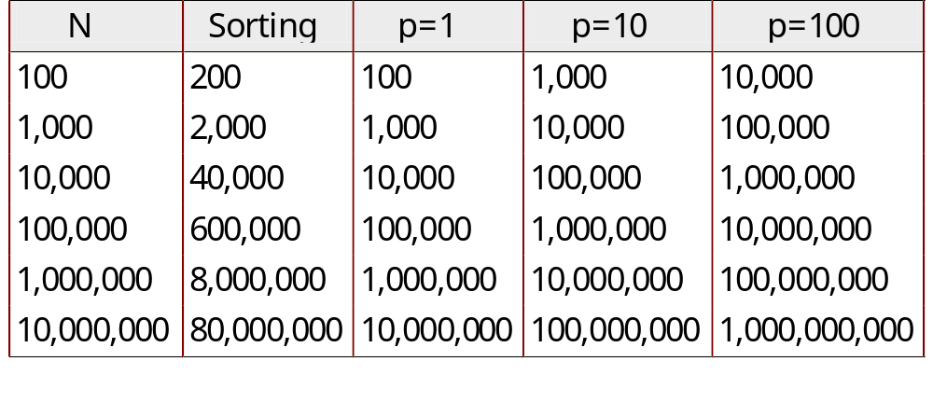
Cost of External Sorting vs. Unclustered Index
N: number of pages of records
p: number of records per page
B=1,000 and block size=32 for sorting
p=100 is the more realistic value.
Notes:
18

Slide 14
Summary
External sorting is important
External merge sort minimizes disk I/O cost:
  Pass 0: Produces sorted runs of size B (# buffer pages). Later passes: merge runs.
  # of runs merged at a time depends on B, and block size.
  Larger block size means less I/O cost per page.
  Larger block size means smaller # runs merged.
  In practice, # of runs rarely more than 2 or 3.
Notes:
19

Slide 15
Summary, cont.
Choice of internal sort algorithm may matter:
  Quicksort: Quick!
  Heap/tournament sort
The best sorts are wildly fast:
  Despite 40+ years of research, still improving!
Clustered B+ tree is good for sorting; unclustered tree is usually very bad.
Notes:
19

